Slide 1



Bhagavad Gita Lessons for Modern Life
Created By: Gaurang Raval
Date: 30/05/2025

Slide 2

CONTENTS
1. Introduction
2. Why Gita is Timeless
3. Lesson 1 – Do Your Duty Without Attachment
4. Lesson 2 – Control Your Mind
5. Lesson 3 – Face Your Fears
6. Lesson 4 – Stay Detached and Peaceful
7. Gita’s Message for Youth
8. Conclusion
9. Thank You / Questions

Slide 3

01
Introduction

Slide 4
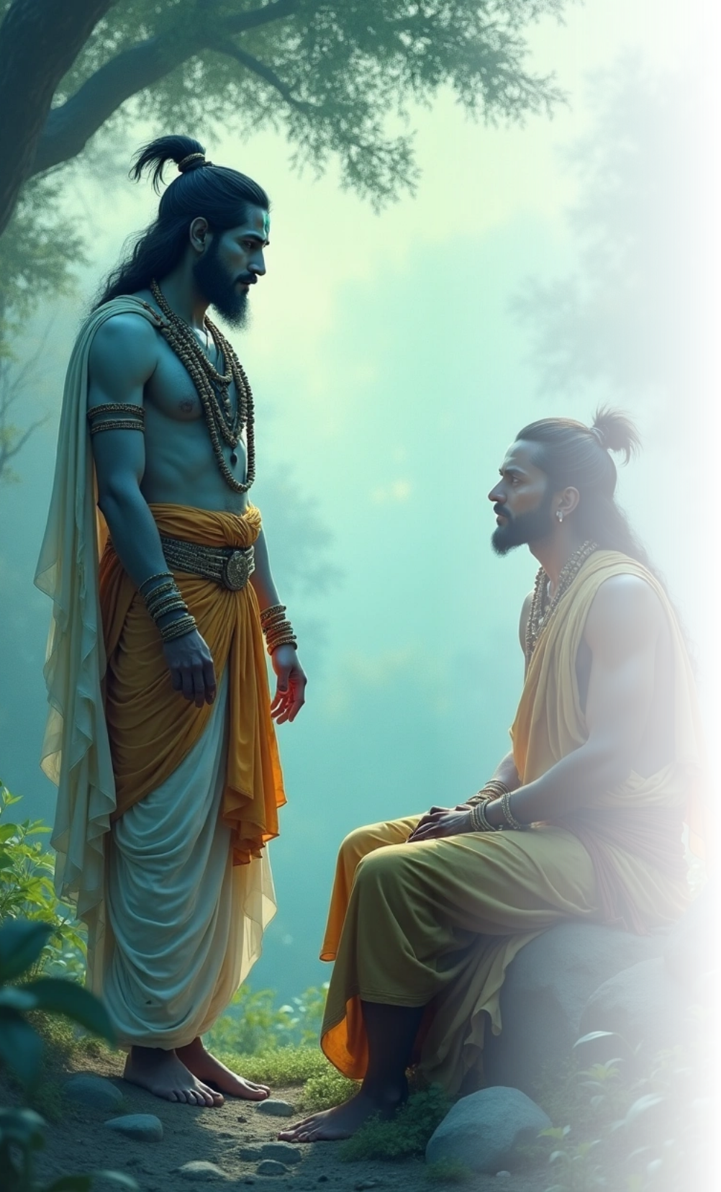

Introduction
1
What is the Bhagavad Gita?
•A spiritual dialogue between Lord Krishna and Arjuna
•Part of the Mahabharata (700 verses)
2
Why is it important today?
•Offers guidance on stress, decision-making, and peace

Slide 5

02
Why Gita is Timeless

Slide 6




Why Gita is Timeless
Religious View
Life Lessons
Targeted Audience
Mental Health
Not bound to any one religion
Universal life lessons
Useful for students, professionals, leaders
Helps manage mental and emotional challenges

Slide 7

03
Lesson 1 – Do Your Duty Without Attachment

Slide 8

Lesson 1 – Do Your Duty Without Attachment
Shloka
•"कर्मण्येवाधिकारस्ते मा फलेषु कदाचन ।"
Key Points
•Focus on your work, not on results
•Example: Study sincerely, don’t worry about marks
•Builds focus, reduces stress

Slide 9

04
Lesson 2 – Control Your Mind

Slide 10



Lesson 2 – Control Your Mind
Mind's Role
Self-Discipline
Avoid Distractions
"Mind can be your best friend or worst enemy"
Practice self-discipline, meditation, and focus
Real-life: Stay away from distractions (social media, negative thoughts)

Slide 11

05
Lesson 3 – Face Your Fears

Slide 12

Lesson 3 – Face Your Fears
Key Concept
•Arjuna's confusion = Our modern dilemmas
Krishna's Teaching
•Be brave and do your dharma
•Real-life: Overcome fear of failure, take action with courage

Slide 13

06
Lesson 4 – Stay Detached and Peaceful

Slide 14



Lesson 4 – Stay Detached and Peaceful
Emotional Involvement
Balance Success and Failure
Anxiety Reduction
Be involved, but don’t get emotionally attached to outcomes
Reduces anxiety and boosts resilience
Accept success and failure with balance

Slide 15

07
Gita’s Message for Youth

Slide 16
Gita’s Message for Youth
1
Character Development
2
Confidence and Peace
3
Daily Guidance
Self-confidence and inner peace
Read one shloka a day for lifelong guidance
Build strong character and clarity of thought

Slide 17
08
Conclusion

Slide 18



Conclusion
Life Manual
Arjuna's Journey
Krishna's Wisdom
Gita is not just a holy book, it’s a life manual
Be like Arjuna: from confusion to courage
Let Krishna's wisdom guide your journey

Slide 19

Thank You

